Slide 1
NETWORK AUTOMATION & PROGRAMMABILITY
SE Tech Summit
Edward Arcuri
Oliver Schuermann
automationNation@juniper.net

Slide 2
At the end of this session you should be able to:
Explain what automation is
Explain SDN (what it is and how you get there)
Explain shift in the industry
Explain piece parts and what that means
Explain the Juniper automation stack
Explain IT frameworks
Explain building blocks and programing languages
Explain classification and automation tools
Explain how to sell automation

Slide 3

Agenda
Intro and Legal Disclaimer
How to Sell Automation
Why Automate?
SDN
Junos Automation Stack
Frameworks
Building Blocks
DIY
Stuff to go

Slide 5

How Do I Sell Automation?
Bridging the value gap with Automation
Automation is not the product
Automation is the differentiator
If only it were that easy

Slide 6
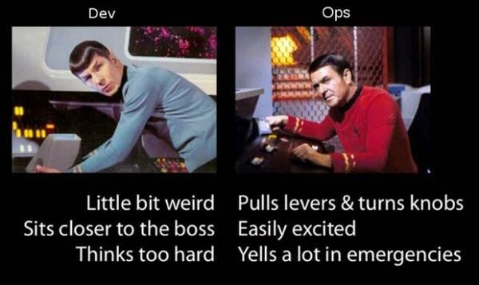
Know Your Customer
Who are your customers?
Network engineers & Architects
Operators
IT/Sys-admins & DevOps
What problems are they trying to solve?
What products are they using today?
Are they automation products?
What have they evaluated already?
Do they like to develop in-house tools?
What are the typical workflows for that customer?
Are there any special considerations?

Slide 7


Automation – The Hard Part
Not a technical problem, it is cultural
Automation is business driven
Part of a higher level Business Process Model
An engineer’s value is not how much they type at the keyboard
Value comes from identifying needs of the business and implementing it through the appropriate technology
Networks are already highly automated
Notes:
Technical vs. Cultural – We have a lot of different technologies that can solve a lot of consistency and real-time performance problems already (python, IT frameworks – chef, puppet, etc., SNMP fault management, etc.). The problem lies in the fact that automation is something of an abstract concept to most people. They believe it is similar to manufacturing processes (and ultimately the loss of jobs) and that eventually automation will take over and there will be nothing for humans to do. This is a very narrow view and assumes that either A) the engineer is so focused on a few things that they can actually be replaced or B) there is no dynamic aspect to a network and things are done the same way every time they are changed. Anyone who has ever worked on a network of more than 2 end systems knows for a fact that B, in the previous statement, is all out false.
Networks are already automated – Dynamic routing is a good example. If you were to ask someone to implement a semi-large network using static routes only, they would look at you like you are crazy. “What would we do when a link goes down?” Indeed. We already allow dynamic routing protocols make changes, to the local device based on local information, based on a fault. Performance issues are a type of fault (though not catastrophic at the time) and faults in other parts of the network should be able to affect other devices in a positive way. FECN, bECN and 802.1au are all examples of trying to implement a protocol that does this based on local device information and trying to share it with others.
DDoS attacks already have automated identification and traffic re-route (to a black hole or impersonation site) implemented a no one sees that as out of the ordinary. What if we could prevent performance/congestion/efficiency/utilization issues before they happened?

Slide 8
JUNOS AUTOMATION
Why Automate?

Slide 9
Why Automate?
Efficiency
Consistency
Uptime

Slide 10

ZTP – Low Hanging Fruit
Notes:
Slide 6 – So enter ZTP, which is really the “Low Hanging” fruit in the automation world, as it has one of the highest return on investments and fairly straightforward to automate.

Slide 11




The Old Way
Junos Config
Switch
EX4300
Notes:
As demand for bandwidth grows naturally networks grow. Also, the required number of devices to sustain today’s requirement for bandwidth continues to grow. This means the deployment of more and more devices. And as you may already know, the deployment of equipment can be one of the most expensive thing you can do in your network. I don’t mean just expensive from a cost perspective, but also from a time perspective. Think about how we traditionally deploy equipment. First we receive the “box” or container that the device is shipped in. Then we open the box and begin to build a configuration. This is done either from Scratch or by doing a “find & replace” on a “known good configuration” to generate this configuration. Once complete you then console to the device, install the configuration, save your work and either rack your device or return it to the box and ship it to it’s final destination.

Slide 12


ZTP – Premise
you have a few of these ....
…and a lot of these
Notes:
ZTP is built around the concept that you have a few, expensive, architect type resources, and that there typically are an abundance of less expensive resources that can rack, cable and power equipment. “Smart hands” if you will. In fact one of the first applications of this was around a large retail company that had more that 5,000 us locations that did not want to stage, nor want to send individuals out to each site. They wanted to store managers to install this equipment. In this case the device for deployment was a branch SRX.

Slide 13





ZTP – How to Automate
Hello World
Campus Building
Junos Version
SNMP (13.3)
Push Template
Bootstrap
Datacenter
DHCP/TFTP
1
2
3
4
Templates
Switches
WLC
Notes:
Let’s look at ZTP from a most basic standpoint. To begin the installation process a device is simply unboxed with a factory default configuration, installed on the network and powered. This can be done by just about anyone that can follow basic instructions.
Once the device is powered it will request an address via DHCP ( or Dynamic Host Configuration Protocol), where it will get a response containing one or more VSAs (or vendor specific attributes). These VSAs will define the version of the Junos Operating system that the device should use, upgrade if necessary and then install an initial (bootstrap) configuration on the device. In the simplest form of the Juniper ZTP process, the device then sends a message to the Junos Space Network Director Management platform and an operator can push previously defined templates to configure the device or in some form or fashion begins to configure the device from there.

Slide 14
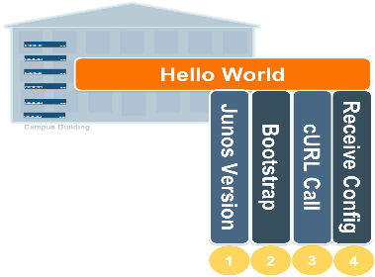



ZTP - Advanced
DHCP
TFTP
Advanced ZTP
Step 2
Step 4
Step 1
Step 3
Junos Device
Step 5
Junos Space
Notes:
Basic ZTP is where some other vendors leave off. But with the advanced automation capabilities of the Junos Operating system, we can take this many steps further and create custom solutions to fit most any need. This slide outlines a slightly more advanced process. Here you will note that steps 1 and 2 are identical. In truth step 2 is slightly different. Instead of passing a basic configuration that gives the device the ability to “phone home” back to Junos Space Network Director, the config contains a SLAX script that kicks off a cURL call that passes an attribute about the device to some type of server that is listening for this type of call.
This attribute can be any number of things on the device. Serial number, LLDP information of upstream ports, IP address of an interface and so on. Once this is passed to the listening server you can then use modern processes to create a config on the fly and pass it back to the device directly via netconf or use the Space APIs to integrate with Junos Space. There are many advanced options and too many to cover here. The main take-away here is that Junos Automation is highly-customizable.

Slide 15
Why Automate?
Efficiency
Consistency
Uptime

Slide 16

What Can Inconsistency Do For You?
Planned Maintenance
Hardware and software upgrades
Unplanned Events
Network failures, hardware events and software defects
Junos Automation
70%
Human Factors
Configuration changes that negatively impact network performance
Notes:
16

Slide 17
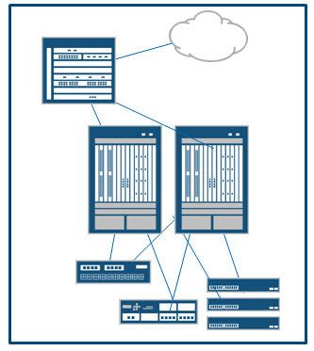







Consistency Via Templates
Network Engineering team validates Junos solution
This activity results in a set of "Golden Configurations" for device commissioning and service deployment
These configurations are copied off the devices in "curly-brace" or "set" format and the Engineers identify the variables
Network Engineering then creates the "templates" from these configurations by adding variable placeholders and macros directly into the Junos configuration
These templates are stored for later use by the Network Operations team
Engineering
Junos Configuration
system {
host-name switch-14-02-42-01;
domain-name mycorp.net;
backup-router 10.176.31.1 destination 10.0.0.0/8;
time-zone America/Los_Angeles;
}
Junos Template
system {
host-name ${Hostname};
domain-name mycorp.net;
backup-router ${BackupRouter} destination 10.0.0.0/8;
time-zone ${TimeZone};
}
The process to create Junos templates is a "write once" model. That is, the Network Engineers create these templates for the operations team to use. The operations teams do not create/modify the templates.
Template Repository

Slide 18
What Can Inconsistency do for you?
Planned Maintenance
Hardware and software upgrades
Junos Automation
Unplanned Events
Network failures, hardware events and software defects
70%
Human Factors
Configuration changes that negatively impact network performance
Notes:
18

Slide 19



Orchestration With Junos Space
Use With Existing NMS, OSS/BSS Deployments
Continue leveraging your existing investment / MoM strategy
OSS/BSS
RESTful APIs
Northbound APIs allow you to easily integrate into existing NMS or OSS/BSS deployment
Junos Space
Management Applications
3rd Party Apps
Junos Space SDK / API
Shared Services EMS Functionality Common Infrastructure
Junos Space Network Management Platform
Open Device API

Slide 20







Service Automation Built Into Junos
Network Elements
Junos collects information, reports issues and needed information for analysis
Service Now and Service Insight Applications on Junos Space
Management point for automation
Connects customer’s network to Juniper
Control point for security, information flow and service enrollment
Service Now and Service Insight
Juniper – JTAC, Consultants
Case management
Tools and systems
Partner /Customer
Juniper
Juniper Engineers

Slide 21

The Promise of SDN
Fully integrated Rainbow Unicorn Butterfly Kitty
Notes:
First, let’s get the elephant in the room out of the way. We are *not* necessarily talking about SDN. Some of the main tenants of SDN are a centralized control plane, separated data plane, programmatic access and new protocols to handle that separation.
Automation and programmability can part of the SDN paradigm, but you can actually do A&P without having to be an SDN purist (centralized control plane, etc.)
Now the promise of SDN is sort of like the picture above. It’s a bit of a fantasy, but it is also something that we must reach for (and ultimately fall short of everything promised) just to take a large step forward. As the kitty shows, everything would be tightly integrated, looks like it all goes together and really it’s something that you would at least “want.”
The next slide shows where we are – go to it now.

Slide 22

The Reality of SDN
At least it’s a cat, right?
Notes:
So here’s the reality. We have a unicorn kitty, but it’s totally half-assed and the kitty really doesn’t want to be there because it’s not what it’s supposed to be doing. There is a rainbow, but it’s not *part* of the kitty, it’s in the picture but more of an add-on, not integrated. No wings. Maybe they are in v2.0 or whatever.
You get the point. Everybody hypes it up and it always winds up falling short. Parts of it are there but it’s not every what it is made out to be in the beginning.
What does this have to do with automation? Well, we have always had the ability to do the “reality of SDN” at Juniper. Yes, it requires separate items working together, but as a whole, it works together very well, even if the kitty is pissed. ☺

Slide 23
Gartner
SDN
a new approach to designing, building and operating networks that focuses on delivering business agility while lowering capital and operational costs. It is far more than just a new set of APIs designed to replace command line interfaces for managing individual devices.
a shift from (per box) element-based control to network-based control.
Source: Gartner, Ending the Confusion About Software-Defined Networking: A Taxonomy.
.

Slide 24
Definitions
Month
Automation
“Automatically controlled operation of an apparatus, process, or system by mechanical or electronic devices that take the place of human labor”
http://www.merriam-webster.com/dictionary/automation
Day
$$$ Savings
Minute
Automation & Programmability
Programmability
“Having the ability to accept a sequence of coded instruction in order to achieve a specific result”
Notes:
In the context of Junos:
Automation is the ability to programmatically do something that you can do manually. Either through scripting or a full blown software application, all we are doing is abstracting away some of the complication of interacting with the device and allowing computers to do the job for which they were invented.
Programmability is the ability to change how Junos works and allow it to do something that isn’t able to do right out of the box. This mostly means control plane manipulation (SDN anyone?)

Slide 25
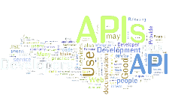


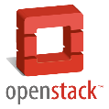

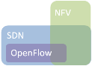


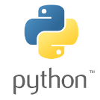




Juniper Automation
Solving real customer technical and business problems at every level
Domain Automation takes the concepts of NaaS, and extends it to an entire domain, including network, compute and storage to deliver end services at a rapid pace and high scale.
Domain
Network
Network Automation aims to abstract the individual platforms, and operate as a “Network As A Service (NaaS)” model. As such, the network is treated as a single entity.
<SLAX>
Platform
Platform Automation focuses on delivering programmatic access to individual components in the network to automate day to day activities and reduce response times..
Notes:
We can break down automation into 3 main areas at Juniper.

Slide 26
Juniper Automation
<SLAX>
Platform
Platform Automation focuses on delivering programmatic access to individual components in the network to automate day to day activities and reduce response times..
Notes:
We can break down automation into 3 main areas at Juniper.

Slide 27
Juniper Approach
Operating System
Management Plane
Control Plane
Data Plane
Notes:
All devices, whether Junos, IOS, whitebox, whatever will have a data forwarding plane and an OS on top of it that controls information going into the data plane.

Slide 28
Juniper Approach
Standardized Interfaces
Management Plane
Control Plane
Data Plane
Notes:
Inside the OS resides a control plane that interacts with the data plane and a management plane that provides instructions for the control plane (along with a myriad of other items – but lets just generalize here for a bit).
At Juniper, we have seen that the purist SDN view has some flaws (especially the centralized control plane) but by abstracting and centralizing the management plane (so to speak, there is still a management plane on all devices) we can interact with the network as a whole entity.
GOTO next slide

Slide 29
Juniper Approach
Management Plane
Standardized Interfaces
Control Plane
Control Plane
Control Plane
Control Plane
Control Plane
Control Plane
Data Plane
Data Plane
Data Plane
Data Plane
Data Plane
Data Plane
Notes:
AND if there are a set of standardized interfaces/protocols between the mgmt. plane and the devices, we can now programmatically access any device, regardless of the vendor and as long as they follow the specifications. Juniper utilizes NETCONF, YANG, REST, Thrift and other standardized protocols and interfaces to allow programmatic management of all our devices.

Slide 30

Junos Automation Stack
Python Scripts
Ansible
Salt*
Ruby Scripts
Puppet
Chef
JSNAP
CLIRA*
JET API
PyEZ Framework
RubyEZ Library
Python / SLAX
NETCONF
Junoscript
REST
CLI
THRIFT
XML-RPC
jVision Sensor
SNMP RO
Chassis
Data Plane (PFE)
Junos Platform Automation Stack
* In development
Notes:
We have built the Junos Automation Stack and this available on all Junos devices (os versions noted where applicable)
Some people believe that, in theory, any entity in the IT universe can be automated -- all it takes is a little scripting! There is a huge difference between products that can be potentially automated -- and those that are designed to be automated.
Junos is designed to be automated.
Driving to successively more productive levels of automation can be directly impacted by how automate-able the components are. Especially if you see yourself on an inevitable journey of progressively deeper and more extensive automation.

Slide 31
Junos Automation Stack
Junos has had automation features consistently added over the past 15+ years.
This heritage of feature innovation has allowed Juniper to deliver new features by building on top of the abstraction layer below.
Python Scripts
Ansible
Salt*
Ruby Scripts
Puppet
Chef
JSNAP
CLIRA*
JET API
PyEZ Framework
RubyEZ Library
Python / SLAX
NETCONF
Junoscript
REST
CLI
THRIFT
XML-RPC
jVision Sensor
SNMP RO
Chassis
Data Plane (PFE)
Junos Platform Automation Stack
Notes:
We have built the Junos Automation Stack and this available on all Junos devices (os versions noted where applicable)
Some people believe that, in theory, any entity in the IT universe can be automated -- all it takes is a little scripting! There is a huge difference between products that can be potentially automated -- and those that are designed to be automated.
Junos is designed to be automated.
Driving to successively more productive levels of automation can be directly impacted by how automate-able the components are. Especially if you see yourself on an inevitable journey of progressively deeper and more extensive automation.

Slide 32
Junos Automation Stack
Python Scripts
Ansible
Salt*
Ruby Scripts
Puppet
Chef
JSNAP
CLIRA*
JET API
PyEZ Framework
RubyEZ Library
Python / SLAX
NETCONF
Junoscript
REST
CLI
THRIFT
XML-RPC
jVision Sensor
SNMP RO
Chassis
Data Plane (PFE)
Junos Platform Automation Stack
Notes:
We have built the Junos Automation Stack and this available on all Junos devices (os versions noted where applicable)
Some people believe that, in theory, any entity in the IT universe can be automated -- all it takes is a little scripting! There is a huge difference between products that can be potentially automated -- and those that are designed to be automated.
Junos is designed to be automated.
Driving to successively more productive levels of automation can be directly impacted by how automate-able the components are. Especially if you see yourself on an inevitable journey of progressively deeper and more extensive automation.

Slide 33
Junos Automation Stack
Technology, as part of the OS, that enables higher level automation and programmability
Python Scripts
Ansible
Salt*
Ruby Scripts
Puppet
Chef
JSNAP
CLIRA*
JET API
PyEZ Framework
RubyEZ Library
Python / SLAX
NETCONF
Junoscript
REST
CLI
THRIFT
XML-RPC
jVision Sensor
SNMP RO
JSD
Ephemeral DB
YANG
jVision
Chassis
Data Plane (PFE)
Junos Platform Automation Stack
Notes:
We have built the Junos Automation Stack and this available on all Junos devices (os versions noted where applicable)
Some people believe that, in theory, any entity in the IT universe can be automated -- all it takes is a little scripting! There is a huge difference between products that can be potentially automated -- and those that are designed to be automated.
Junos is designed to be automated.
Driving to successively more productive levels of automation can be directly impacted by how automate-able the components are. Especially if you see yourself on an inevitable journey of progressively deeper and more extensive automation.

Slide 34
Junos Automation Stack
Monitoring and Analytics technologies
Python Scripts
Ansible
Salt*
Ruby Scripts
Puppet
Chef
JSNAP
CLIRA*
JET API
PyEZ Framework
RubyEZ Library
Python / SLAX
NETCONF
Junoscript
REST
CLI
THRIFT
XML-RPC
jVision Sensor
SNMP RO
JSD
Ephemeral DB
YANG
jVision
Chassis
Data Plane (PFE)
Junos Platform Automation Stack

Slide 35
Junos Automation Stack
Robust APIs that allow for device interaction using multiple languages
Python Scripts
Ansible
Salt*
Ruby Scripts
Puppet
Chef
JSNAP
CLIRA*
JET API
PyEZ Framework
RubyEZ Library
Python / SLAX
NETCONF
Junoscript
REST
CLI
THRIFT
XML-RPC
jVision Sensor
SNMP RO
JSD
Ephemeral DB
YANG
jVision
Chassis
Data Plane (PFE)
Junos Platform Automation Stack

Slide 36
Junos Automation Stack
Standardized interfaces for device connectivity and operations
Python Scripts
Ansible
Salt*
Ruby Scripts
Puppet
Chef
JSNAP
CLIRA*
JET API
PyEZ Framework
RubyEZ Library
Python / SLAX
NETCONF
Junoscript
REST
CLI
THRIFT
XML-RPC
jVision Sensor
SNMP RO
JSD
Ephemeral DB
YANG
jVision
Chassis
Data Plane (PFE)
Junos Platform Automation Stack

Slide 37
Junos Automation Stack
Python Scripts
Ansible
Salt*
Ruby Scripts
Puppet
Chef
JSNAP
CLIRA*
Junos Extension Toolkit (JET)
Published APIs used by Juniper development as well as customers
JET API
PyEZ Framework
RubyEZ Library
Python / SLAX
NETCONF
Junoscript
REST
CLI
THRIFT
XML-RPC
jVision Sensor
SNMP RO
JSD
Ephemeral DB
YANG
jVision
Chassis
Data Plane (PFE)
Junos Platform Automation Stack

Slide 38
Junos Automation Stack
Frameworks and libraries to abstract underlying connection and XML data for faster adoption and integration with scripts written in popular languages
Python Scripts
Ansible
Salt*
Ruby Scripts
Puppet
Chef
JSNAP
CLIRA*
JET API
PyEZ Framework
RubyEZ Library
Python / SLAX
NETCONF
Junoscript
REST
CLI
THRIFT
XML-RPC
jVision Sensor
SNMP RO
JSD
Ephemeral DB
YANG
jVision
Chassis
Data Plane (PFE)
Junos Platform Automation Stack

Slide 39
Junos Automation Stack
Python Scripts
Ansible
Salt*
Ruby Scripts
Puppet
Chef
JSNAP
CLIRA*
Support for modern scripting languages with direct access to the Juniper device OS for operations and management
JET API
PyEZ Framework
RubyEZ Library
Python / SLAX
NETCONF
Junoscript
REST
CLI
THRIFT
XML-RPC
jVision Sensor
SNMP RO
JSD
Ephemeral DB
YANG
jVision
Chassis
Data Plane (PFE)
Junos Platform Automation Stack

Slide 40
Junos Automation Stack
Juniper supported integrations and agents for use with DevOps frameworks.
Juniper developed workflow and operational applications that use the Junos automation stack
Python Scripts
Ansible
Salt*
Ruby Scripts
Puppet
Chef
JSNAP
CLIRA*
JET API
PyEZ Framework
RubyEZ Library
Python / SLAX
NETCONF
Junoscript
REST
CLI
THRIFT
XML-RPC
jVision Sensor
SNMP RO
JSD
Ephemeral DB
YANG
jVision
Chassis
Data Plane (PFE)
Junos Platform Automation Stack

Slide 41
Junos Automation Stack
Python Scripts
Ansible
Salt*
Ruby Scripts
Puppet
Chef
JSNAP
CLIRA*
Simplicity
JET API
PyEZ Framework
RubyEZ Library
Python / SLAX
Flexibility
NETCONF
Junoscript
REST
CLI
THRIFT
XML-RPC
jVision Sensor
SNMP RO
Chassis
Data Plane (PFE)
Junos Platform Automation Stack
Notes:
The Junos Automation Stack is extremely powerful and is packed with features that allow for practically everything on a Junos device to be automated.
But remember, as you get further away from the direct OS interaction, there are abstractions that happen that could remove some flexibility of command choice and/or OS manipulation. For most, IT frameworks and basic scripts will be enough to push configuration and get basic status. But when more and more information is needed from the network, you must delve deeper into the stack and use things like JET apps and YANG models to truly unleash the power of an automated Junos platform and make the idea of an “SDN” become a reality (fully integrated butterfly rainbow kitty optional)

Slide 42
Juniper Approach
Management Plane
Standardized Interfaces
Control Plane
Control Plane
Control Plane
Control Plane
Control Plane
Control Plane
Data Plane
Data Plane
Data Plane
Data Plane
Data Plane
Data Plane
Notes:
AND if there are a set of standardized interfaces/protocols between the mgmt. plane and the devices, we can now programmatically access any device, regardless of the vendor and as long as they follow the specifications. Juniper utilizes NETCONF, YANG, REST, Thrift and other standardized protocols and interfaces to allow programmatic management of all our devices.

Slide 43
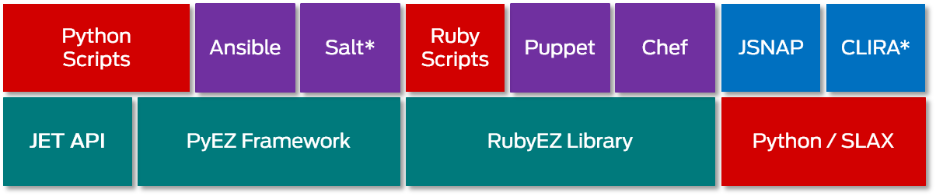
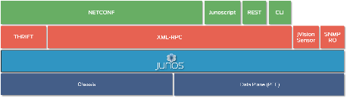
Juniper Approach
Management Plane
Control Plane
Control Plane
Control Plane
Control Plane
Control Plane
Control Plane
Data Plane
Data Plane
Data Plane
Data Plane
Data Plane
Data Plane
Notes:
AND if there are a set of standardized interfaces/protocols between the mgmt. plane and the devices, we can now programmatically access any device, regardless of the vendor and as long as they follow the specifications. Juniper utilizes NETCONF, YANG, REST, Thrift and other standardized protocols and interfaces to allow programmatic management of all our devices.

Slide 44
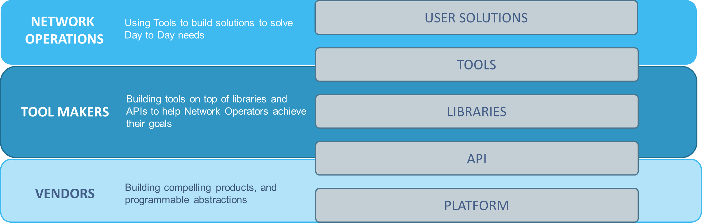
Automation Tooling
Different tools, aimed at different groups in the solution delivery chain

Slide 45
JUNOS AUTOMATION
IT Frameworks

Slide 46


Puppet
Puppet Master
(server)
EX | QFX | MX
"netdev"
Puppet "netdev" module
"netdev" is a Puppet module stored on the Puppet master. The device running the Puppet agent downloads this code via SSL
Puppet Agent (client)
NETCONF "gem"
jpuppet package
Ruby Interpreter
Junos products are equipped with a NETCONF API that enables programmatic configuration changes and operational management via secure XML RPC
NETCONF
(FreeBSD)
Notes:
Start with the overview of JUNOS puppet architecture…
Puppet is server/client model, in which master is the central control point, responsible for all the clients configuration deployment, modification. Clients, expanded from its traditional component Server, are get Juniper various switches platforms involved. Junos switches are equipped with a NETCONF API that enables programmatic configuration changes and operational management via secure XML RPC. To be able to support Junos switch on the server side, We have created "netdev“ module stored on the Puppet master. The switch running the Puppet agent downloads this code via SSL.
One additional point on the “netconf” API… Even though the current Juniper Puppet solution only covers basic vlan, lag, trunk etc Layer2 functions, but the “netconf” based solution technically is fairly powerful to support all features/functions delivered by the normal CLI. It’s only matter of time, and resources committed on this solution to get more functions supported in the near future, such as Layer3, routing protocols, ACLs, and policies etc.

Slide 47






Chef
Chef Server
EX | QFX
Enterprise Chef
Hosted Enterprise Chef
Open Source Chef
node object
Chef
SDK package
Chef Agent (client)
cookbook
Ruby Interpreter
Chef Workstation
rb-junos-ez
cookbook
net-netconf
knife
XML
Chef repository
Notes:
This brings us to the CHEF CLIENT INTEGRATION we are demonstrating today.
How does it work?
You are probably familiar with Chef – Cookbooks are placed on the Chef Server which are queried from the client and associated configuration changes are downloaded to device.
The CHEF CLIENT in JUNOS, takes these configuration changes, and by way of the Ruby interpreter sends them to the ruby junos ez api and onto netconf. Netconf client in turn takes these inputs and converts them into xml statements which are read by the JUNOS configuration engine.
Efficient , Consistent and most of all Secure

Slide 48


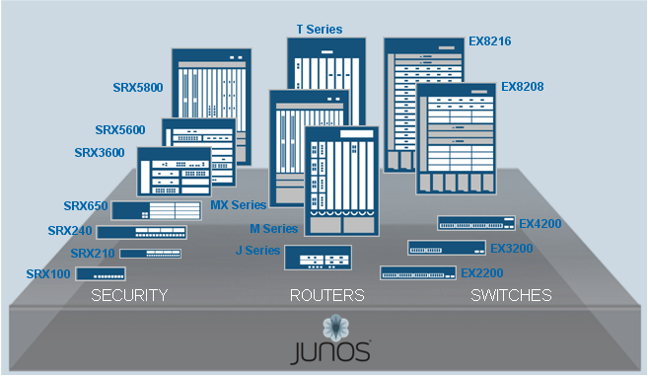
Ansible
Agentless and simple approach
Does not require coding skills (YAML)
Work flow Engine
Ansible
Transports
Python API
Plugins
Module
Library
Security
Routing
Switching
Playbook
Files
junos_install_os
junos_reboot
Telnet/Console
junos_install_config
SSH
junos_get_facts
junos_shutdown
NETCONF
Notes:
Ansible is a radically simple IT automation platform that makes deploying Junos devices pretty simple. You can avoid writing scripts or custom code to deploy and update the devices and you can automate in a language that approaches plain English (YAML), using SSH, with no agents to install on the devices.
Juniper has supported modules for push types of scenarios only. Ansible isn’t very good for pulling data and manipulating it.
With the Juniper supported modules you can:
Upgrade Junos
Push configuration changes (either as curly brace, XML or set commands)
Get facts about the device (model, OS version, serial numbers, etc.)
Remotely shutdown the device

Slide 49




JSNAP
ospf-int-checks {
command show ospf interface;
iterate ospf-interface {
is-gt neighbor-count, 0 {
info OSPF interfaces must have at least 1 neighbor;
err "OSPF interface %s does not have any neighbors", interface-name;
}
}
}
"BEFORE"
SNAPSHOT
"AFTER"
SNAPSHOT
bsmith@server$ jsnap --snap preupgrade -l bsmith -t ABC ABCsnapshot.conf
bsmith password:
Connecting to bsmith@ABC ...
CONNECTED.
EXEC: 'show ospf interface' ...
SAVE: 'ABC__ospf-int-checks__preupgrade.xml' ...
bsmith@server$ jsnap --check preupgrade, postupgrade -t ABC ABCsnapshot.conf
---------------------------------------------------------------
CHECKING SECTION: ospf-int-checks
---------------------------------------------------------------
+ TEST PASSED: OSPF interfaces must have at least 1 neighbor
"COMPARE"
SNAPSHOTS
Notes:
Everyone that has seen this wants this. Automation solving a huge problem. Current network operations teams struggling to solve this solution manually or with home-grown systems. Complexity in network is overtaxing operations teams. Juniper automation solution is a "coding free" program; i.e. operations team doesn't need to write programs to solve this problem.

Slide 50
JUNOS AUTOMATION
Building Blocks

Slide 51



On Box Automation
Think globally, automate locally
Users can write their own
commit, op and event scripts.
Commit Script
Run every time a user commits the configuration, can help with automation and consistency
Commit
Scripts
Op
Scripts
Event
Scripts
Junos Script API
Op Script
Initiated by an operator, help in troubleshooting, configuration, monitoring
The Junos Script API allows
Access to Junos commands,
configuration, and state data.
Event Script
Initiated by an event policy and allow automation and troubleshooting
Notes:
Commit scripts are run as part of the standard Junos commit process and provide the ability to change the configuration, display warnings, cancel the commit, etc. Op scripts are essentially custom CLI commands. They are typically invoked from the CLI with the “op” command. Their uses vary but custom display commands are common. These can be run off box as well by using the NETCONF protocol Event scripts are run automatically in response to a Junos event.

Slide 52
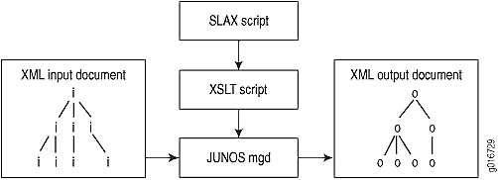
SLAX
Supports both On and Off-box automation
Syntax overlay for XSLT programming language
On-box scripting for op, event and commit
Off-box scripting for op and pre-emptive commit
Notes:
Stylesheet Language Alternative Syntax (SLAX) is a language for writing Junos OS commit scripts, op scripts, and event scripts. It is an alternative to Extensible Stylesheet Language Transformations (XSLT). SLAX has a distinct syntax similar to that of C and Perl, but the same semantics as XSLT.
More info can be found at: http://www.juniper.net/documentation/en_US/junos13.3/topics/concept/junos-script-automation-slax-overview.html

Slide 53


Python On-Box
Enabling Python 2.7 on the box
“Everything” that is possible with SLAX can be done with Python
API is Python/PyEZ
Part of core Junos image
Will be supported on all* platforms supporting Junos release 15.2 or later
ROADMAP*
Notes:
The python on box capabilities are part of the overall JET implementation and as such the ability to run python op, event and commit scripts on-box (which you can do since Junos 4.x with SLAX) will be in Junos 15.2 when JET is released.

Slide 54
PyEZ
Micro-framework
Python framework with easy learning curve
Works with any Junos device running 11.4 or later
Operational and Configuration Data/Management
Generalized utilities for file-system, software-upgrade, scp
Community supported
Notes:
Junos PyEZ is a Python library to remotely manage/automate Junos devices. The user is NOT required: (a) to be a "Software Programmer™", (b) have sophisticated knowledge of Junos, or (b) have a complex understanding of the Junos XML API.
This library was built for two types of users:
For "Non-Programmers" - Python as a Power Shell
This means that "non-programmers", for example the Network Engineer, can use the native Python shell on their management server (laptop, tablet, phone, etc.) as their point-of-control for remotely managing Junos devices. The Python shell is an interactive environment that provides the necessary means to perform common automation tasks, such as conditional testing, for-loops, macros, and templates. These building blocks are similar enough to other "shell" environments, like Bash, to enable the non-programmer to use the Python shell as a power-tool, rather than a programming language. From the Python shell a user can manage Junos devices using native hash tables, arrays, etc. rather than device-specific Junos XML or resorting to 'screen scraping' the actual Junos CLI.
For "Programmers" - Open and Extensible
There is a growing interest and need to automate the network infrastructure into larger IT systems. To do so, traditional software programmers, DevOps, "hackers", etc. need an abstraction library of code to further those activities. Junos PyEZ is designed for extensibility so that the programmer can quickly and easily add new widgets to the library in support of their specific project requirements. There is no need to "wait on the vendor" to provide new functionality. Junos PyEZ is not specifically tied to any version of Junos or any Junos product family.

Slide 55
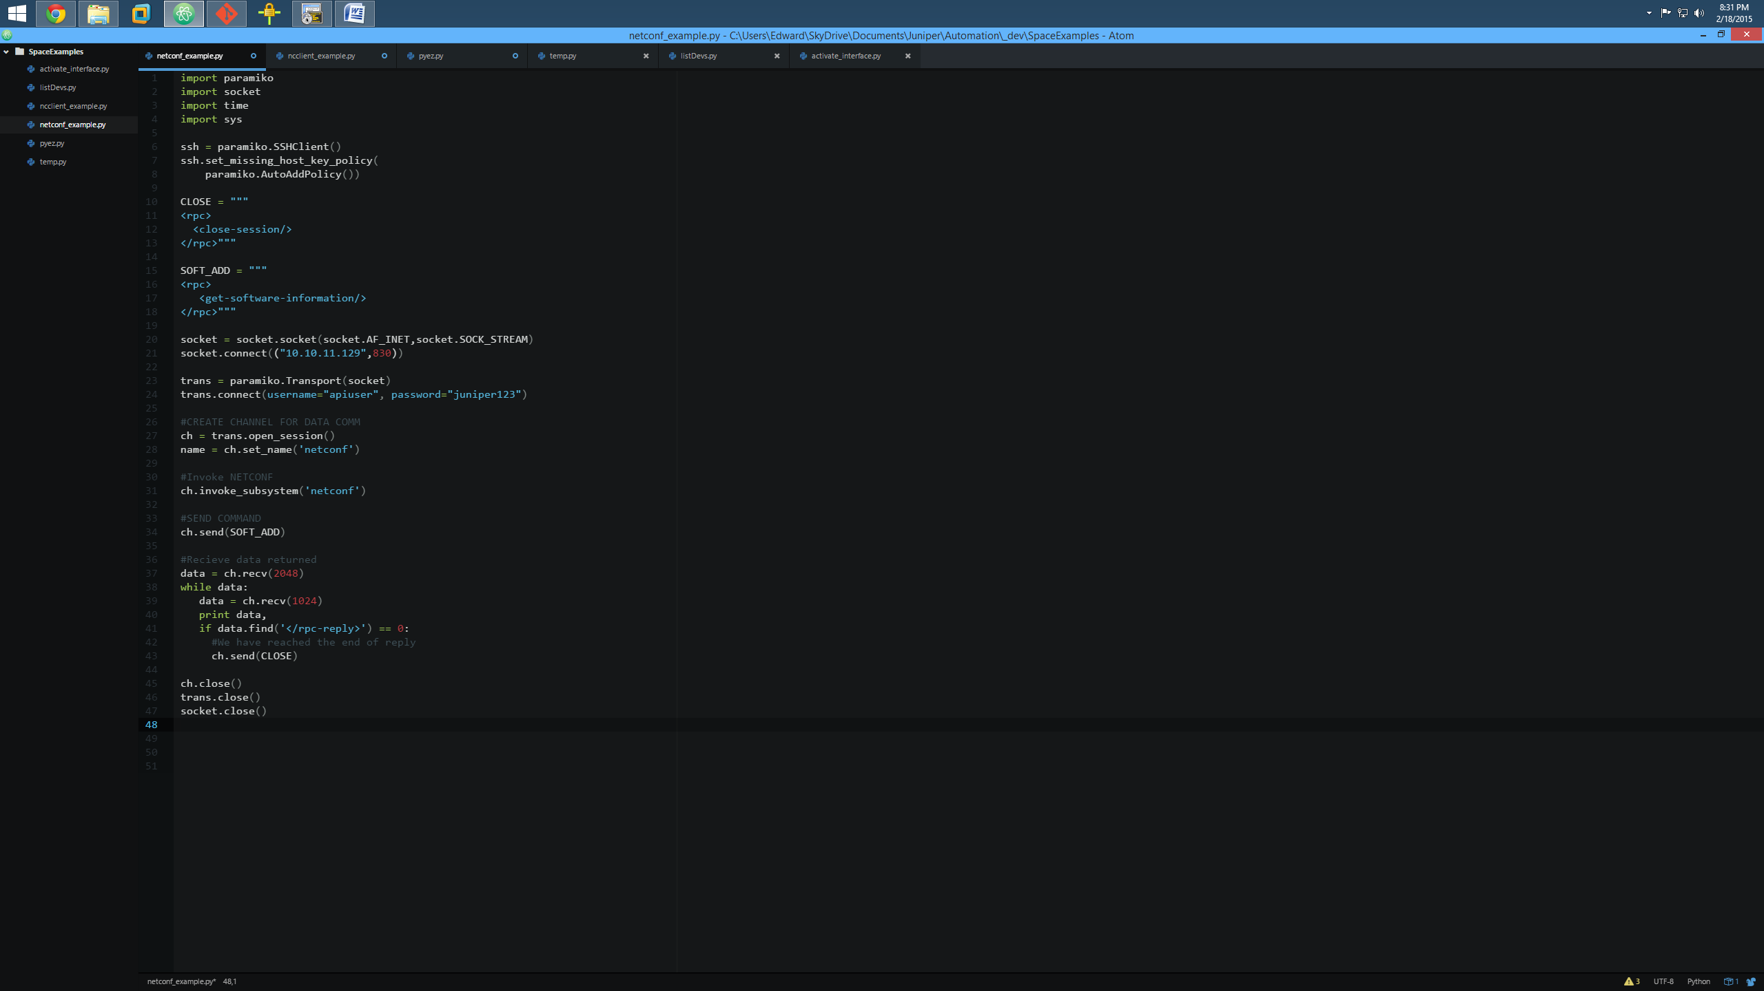
So why is it called “PyEZ” anyway?
Copyright © 2015 Juniper Networks, Inc.
Notes:
The raw python script uses the paramiko library for the ssh connection and you have to define the rpc for show verison (get-software-information), then open the socket to the device on the right port (830) and create the transport using that socket as the connection. Once it’s open, you can then send the rpc and then wait for the end of the rpc-reply. Then close the open session, close the transport and then close the socket.
With ncclient it is much shorter an you really only need to define the basic info (host, user, password), create the connection using that info and then send the ‘show version’ command. This is actually a really crappy example because it isn’t using the rpc, but rather cli commands. Not a good idea in a programmatic sense. Anyway, once you retrieve the command, you can then print it out. This is also a bad example because the script never closes the connection either. This is on the juniper.net website as an example for the QFX 5100. I gotta talk to them. Sheesh.
PyEZ is 7 lines. You define the device you want to talk to, open the connection and it automatically gets not only the show version info (via rpc) but also hardware/serial number info as well and then formats it into JSON from the XML it receives. All in 7 lines. It does a LOT more too with operational and configuration data.

Slide 56
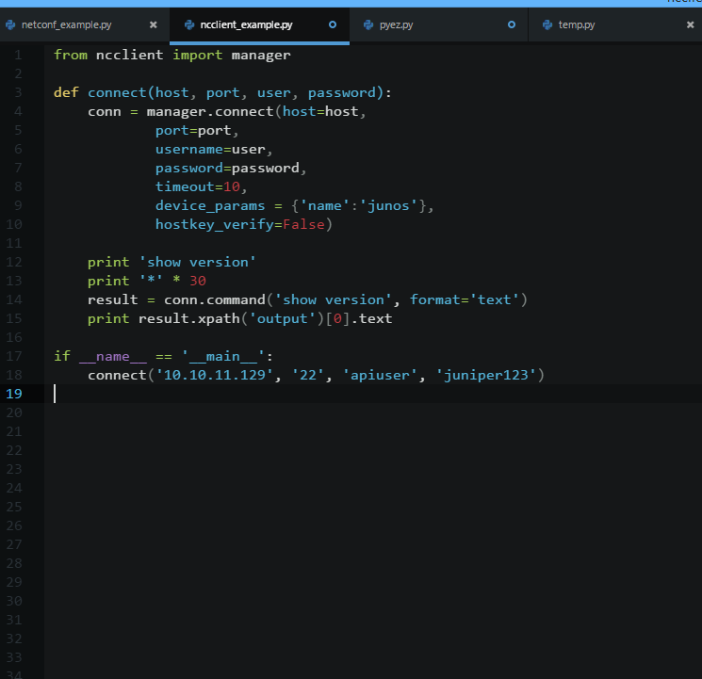
So why is it called “PyEZ” anyway?
Raw Python – 48 lines
Copyright © 2015 Juniper Networks, Inc.
Notes:
The raw python script uses the paramiko library for the ssh connection and you have to define the rpc for show verison (get-software-information), then open the socket to the device on the right port (830) and create the transport using that socket as the connection. Once it’s open, you can then send the rpc and then wait for the end of the rpc-reply. Then close the open session, close the transport and then close the socket.
With ncclient it is much shorter an you really only need to define the basic info (host, user, password), create the connection using that info and then send the ‘show version’ command. This is actually a really crappy example because it isn’t using the rpc, but rather cli commands. Not a good idea in a programmatic sense. Anyway, once you retrieve the command, you can then print it out. This is also a bad example because the script never closes the connection either. This is on the juniper.net website as an example for the QFX 5100. I gotta talk to them. Sheesh.
PyEZ is 7 lines. You define the device you want to talk to, open the connection and it automatically gets not only the show version info (via rpc) but also hardware/serial number info as well and then formats it into JSON from the XML it receives. All in 7 lines. It does a LOT more too with operational and configuration data.

Slide 57
So why is it called “PyEZ” anyway?
Raw Python – 48 lines
ncclient – 19 lines
Copyright © 2015 Juniper Networks, Inc.
Notes:
The raw python script uses the paramiko library for the ssh connection and you have to define the rpc for show verison (get-software-information), then open the socket to the device on the right port (830) and create the transport using that socket as the connection. Once it’s open, you can then send the rpc and then wait for the end of the rpc-reply. Then close the open session, close the transport and then close the socket.
With ncclient it is much shorter an you really only need to define the basic info (host, user, password), create the connection using that info and then send the ‘show version’ command. This is actually a really crappy example because it isn’t using the rpc, but rather cli commands. Not a good idea in a programmatic sense. Anyway, once you retrieve the command, you can then print it out. This is also a bad example because the script never closes the connection either. This is on the juniper.net website as an example for the QFX 5100. I gotta talk to them. Sheesh.
PyEZ is 7 lines. You define the device you want to talk to, open the connection and it automatically gets not only the show version info (via rpc) but also hardware/serial number info as well and then formats it into JSON from the XML it receives. All in 7 lines. It does a LOT more too with operational and configuration data.

Slide 58
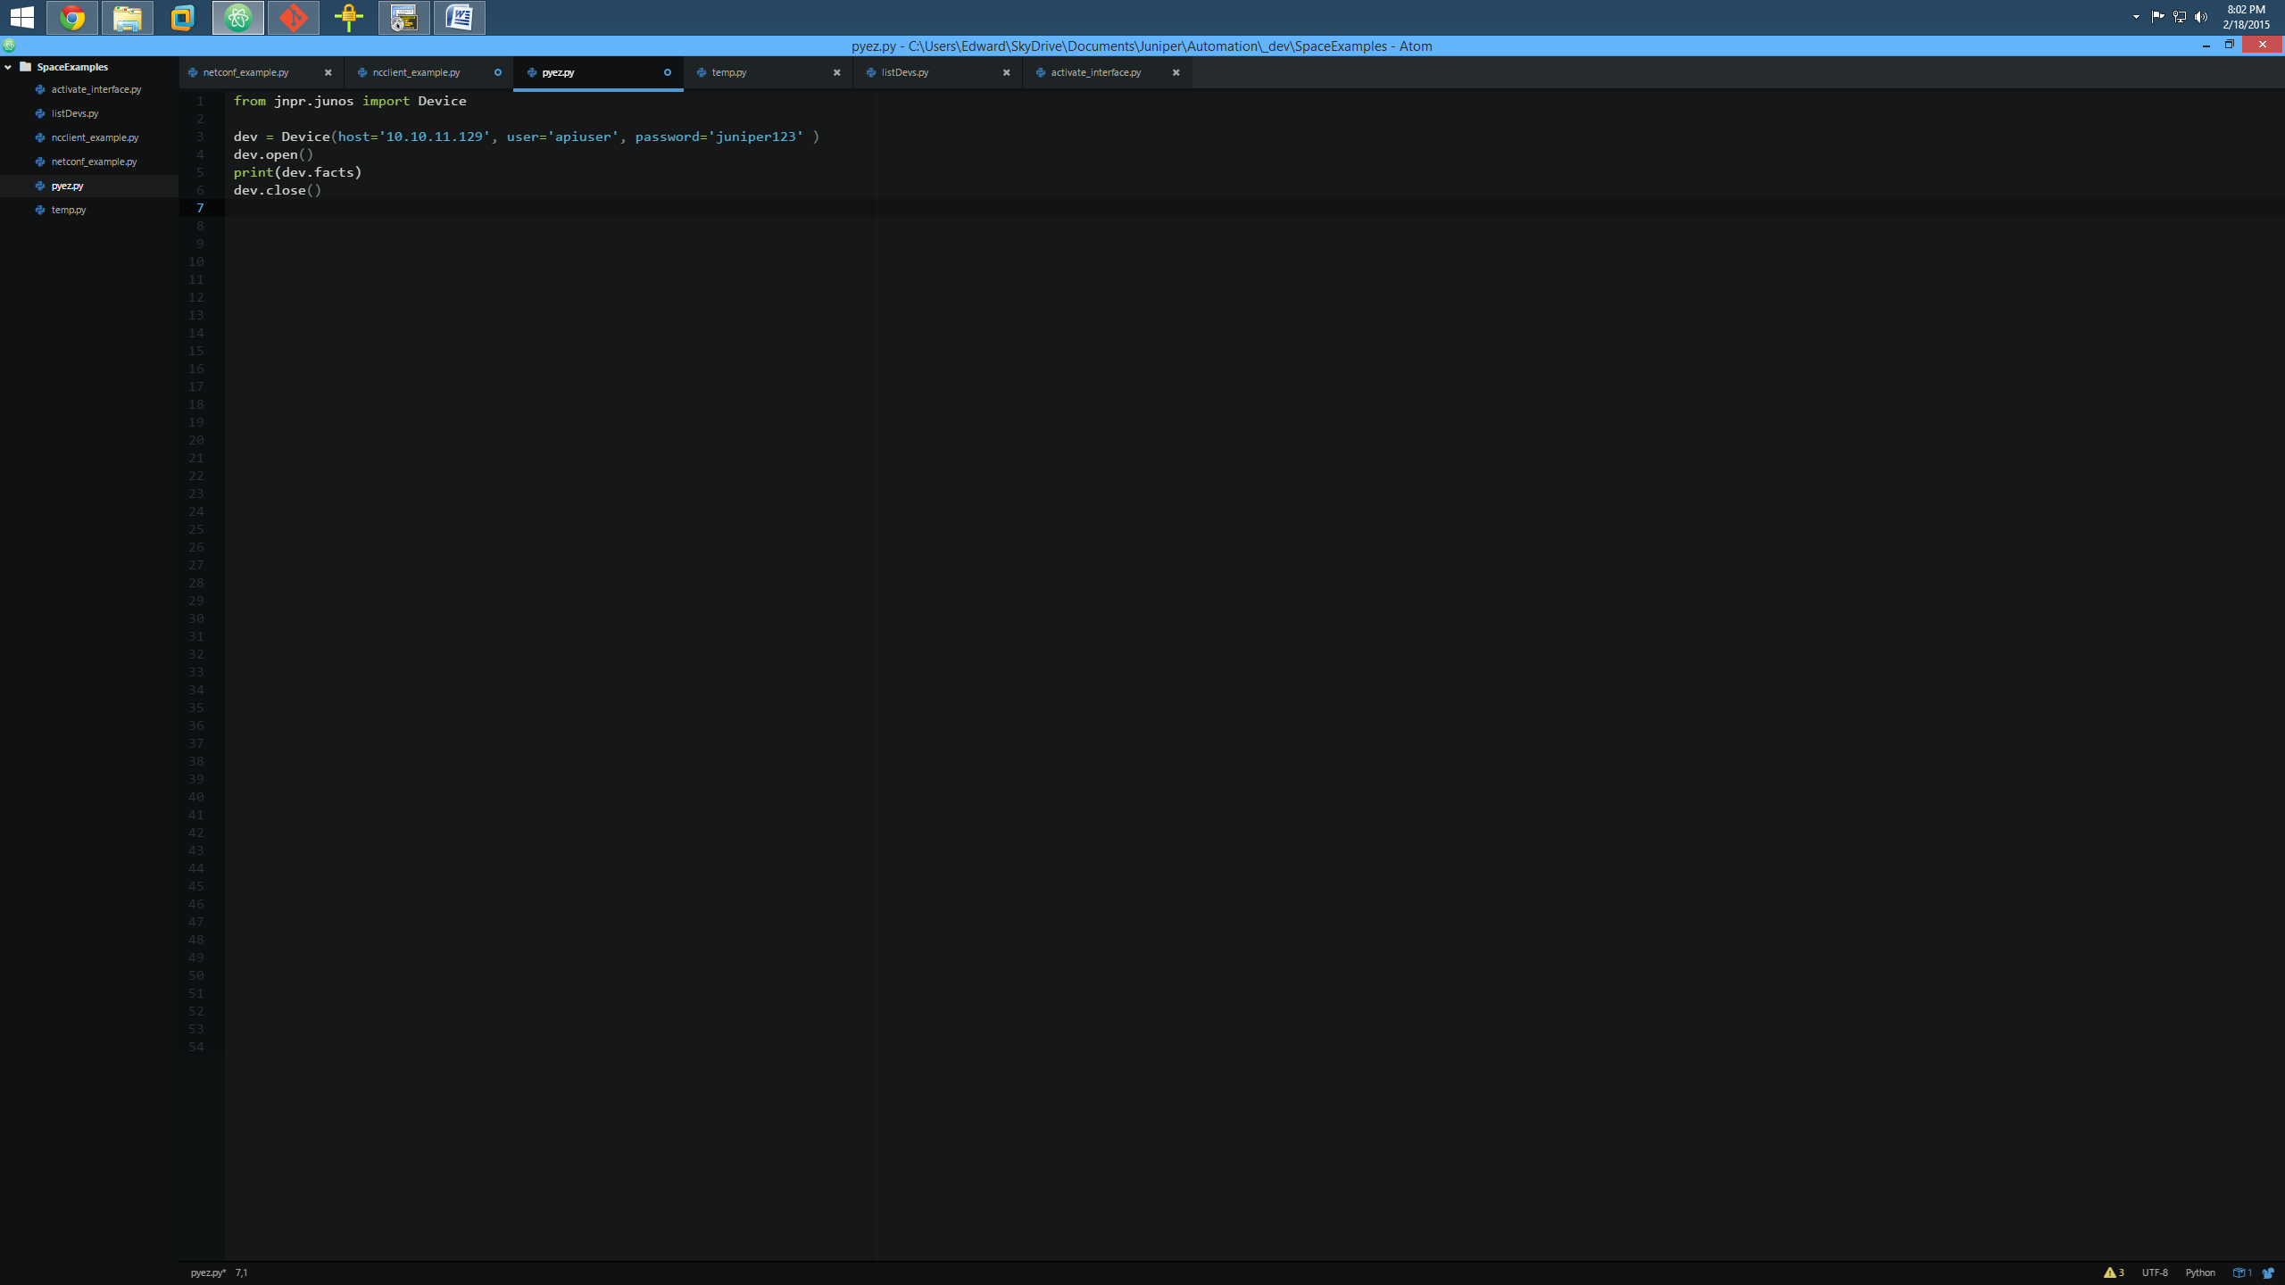
So why is called “PyEZ” anyway?
PyEZ – 7 lines (and gathers more info)
Raw Python – 48 lines
ncclient – 19 lines
All 3 scripts gather ‘show version’ info from the same device
Notes:
The raw python script uses the paramiko library for the ssh connection and you have to define the rpc for show verison (get-software-information), then open the socket to the device on the right port (830) and create the transport using that socket as the connection. Once it’s open, you can then send the rpc and then wait for the end of the rpc-reply. Then close the open session, close the transport and then close the socket.
With ncclient it is much shorter an you really only need to define the basic info (host, user, password), create the connection using that info and then send the ‘show version’ command. This is actually a really crappy example because it isn’t using the rpc, but rather cli commands. Not a good idea in a programmatic sense. Anyway, once you retrieve the command, you can then print it out. This is also a bad example because the script never closes the connection either. This is on the juniper.net website as an example for the QFX 5100. I gotta talk to them. Sheesh.
PyEZ is 7 lines. You define the device you want to talk to, open the connection and it automatically gets not only the show version info (via rpc) but also hardware/serial number info as well and then formats it into JSON from the XML it receives. All in 7 lines. It does a LOT more too with operational and configuration data.

Slide 59
JUNOS AUTOMATION
DIY

Slide 60
Language Choice
NETCONF libraries for those that need them
Language of API | Mode of Distribution | Maturity | Support | URL | Additional Notes
Ruby | Open Source | Most popular. 3200+ downloads. | Open Source | Click | Wins big on ease of installation, features, limited dependencies and active support.
Java | via Juniper website. Will be shortly available on github. | Already being used by enterprise customers. | JTAC | Click | Very simple to get started. Easy on installation. Single .jar file to use/zero dependencies.
Python | Open Source | Based on an already popular open source client. | Open Source. | Click | Favorite language of scripters.
Perl | via Juniper website. | Most ancient of all API’s. Needs work to ease installation | JTAC | Click | Installation of the API is not entirely smooth and needs further work to simplify the process.
PHP | Open Source | Not in a ready to use state yet. | Open Source | Click | Still in development stage.
* It is highly recommended to use PyEZ unless you really need direct NETCONF or other language support.
Copyright © 2015 Juniper Networks, Inc.
Notes:
Even though we have talked mainly about Python, we have other Netconf based libraries that can be used to programmatically access Junos based devices. While Python and PyEZ are our main focus, customers can still utilize other languages that they are more familiar with. Be aware, however, that PyEZ has the most features and velocity behind it with Ruby being second. Anything beyond those are best effort by engineering to enhance.

Slide 61
Resources
Support related
SE-Think-Like-A-Programmer (Internal mailing list)
Python-hackers (Internal mailing list)
Sharepoint
https://junipernetworks.sharepoint.com/sites/members/thinklikeaprogrammer
Github
https://github.com/Juniper/py-junos-eznc/
https://github.com/Juniper/ansible-junos-stdlib
Google
http://groups.google.com/group/junos-python-ez
Techwiki
https://techwiki.juniper.net
https://techwiki.juniper.net/Projects/Junos_PyEZ
API Docs
http://junos-pyez.readthedocs.org/
BLOG
"Python for Non-Programmers": on J-Net Forum

Slide 62
Resources
Tech Pubs (ZTP)
http://www.juniper.net/techpubs/en_US/junos12.3/topics/task/configuration/software-image-and-configuration-automatic-provisioning-confguring.html
http://www.juniper.net/techpubs/en_US/junos13.3/topics/concept/software-image-and-configuration-automatic-provisioning-understanding.html
http://www.juniper.net/techpubs/en_US/junos13.2/topics/concept/junos-flex-overview.html
http://www.juniper.net/techpubs/en_US/junos13.2/topics/task/verification/ztp-qfx-series-monitoring.html

Slide 63
Resources
Advanced ZTP Example
GITHub
https://github.com/jeremyschulman/jctyztp
Open Lab
http://www-int.juniper.net/sales/openlab/
Ansible
Modules
https://github.com/Juniper/ansible-junos-stdlib
Ansible Demo Using Junos FireFly
https://github.com/jeremyschulman/ansible-vsrx-demo
Demo - CSV to Ansible 'hosts' and 'host_vars'
https://github.com/jeremyschulman/ansible-csv2hosts

Slide 64
Resources
Junos PyEZ (templating)
Setup
http://lamejournal.com/category/networking/juniper-networking/junoz-pyez/
http://techwiki.juniper.net/Automation_Scripting/Junos_OS_PyEZ
Jinja2 Examples
https://github.com/jeremyschulman/NCE
http://jinja.pocoo.org/
PyEx Example Videos
Hello World - https://vimeo.com/82835253
Collecting Data off of Multiple Devices - https://vimeo.com/82843211
Device Software Upgrade - https://vimeo.com/95427194
Dynamic Configs via YAML and JinJa2: https://vimeo.com/95445333

Slide 65
Resources
Misc. Links
Github repo: https://github.com/Juniper/py-space-platform
Wiki: https://github.com/Juniper/py-space-platform/wiki
API Docs: http://space-ez.readthedocs.org/en/latest/
Examples: https://github.com/Juniper/py-space-platform/blob/master/examples/README.md

Slide 66

Thank you

